Slide 1
Agence de la santé publique du Canada
Public Health Agency of Canada
Forum national sur la santé et le bien-être des animaux d’élevage
D^{r} Gregory Taylor
Sous-administrateur en chef de la santé publique du Canada
3 décembre 2013
Ottawa (Ontario)

Slide 2
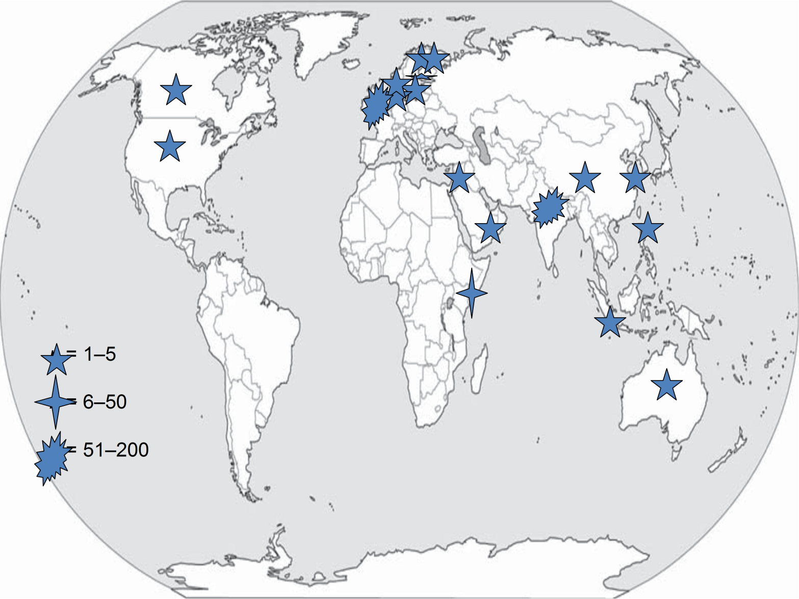
Distribution mondiale des cas de NDM-1* – déc. 2010
(*enzyme/superbactérie New Delhi métallo-bêta-lactamase-1)
Notes:
Important to note that in October of this year, the first case of NDM-producing Salmonella spp. likely acquired in India but detected in the U.S was reported. This is an example of how easily this enzyme is moving between species, and can be introduced into our foodborne pathogens (Salmonella).

Slide 3
L’épidémiologie de la résistance antimicrobienne est complexe…
Éthanol-carburant
AQUICULTURE
Producteurs d’éthanol-carburant
Mer/ lacs
Natation
Eau potable
Sous-produits de céréales à distillerie
Eau potable
Rivières/ ruisseaux
Bactéricides
industriels et
ménagers
Décharge
SOL
Effluents agricoles et épandage de fumier
Eaux d’égout
Chep-tel mort
FAUNE
Équaris-sage
Abats
Végétation,
cultures de semences,
fruits
PORCS
HUMAINS
MOUTONS
BOVINS
PERSONNES
HOSPITALISÉES
COLLECTIVITÉ
- URBAINE
-RURALE
Aliments
pour animaux
Re-mélange
ANIMAUX DESTINÉS À L’ALIMENTA-TION
Abattoirs
commerciaux/
usines de
transformation
Manipulation
Préparation
Consommation
VEAUX
Viande
ÉTABLISSE-
MENTS DE SOINS
PROLONGÉS
VOLAILLE
VOYAGEURS
AUTRES
ANIMAUX
D’ÉLEVAGE
ANIMAUX DE
COMPAGNIE
Contact
direct
IMPORTATIONS
d’après A.H. Linton (1977), modifié par R.J. Irwin
Notes:
There are gaps in our surveillance and we are working to bridge these gaps. Regardless, there are good data coming our of the CIPARS program.
Focus on 5 main species – humans, chickens, pigs, cattle and turkey
Will quickly describe the main findings for each from the 2012 surveillance year.

Slide 4
Résistance au ceftiofur chez des isolats de E. coli (poulets) et de S. Heidelberg (humains et poulets), Québec – PICRA
2003-2009, moyenne mobile
Niveau élevé d’utilisation
Utilisation nulle
Utilisation inconnue
préliminaire
Programme intégré canadien de surveillance de la résistance aux antimicrobiens, ASPC
3
Notes:
3
This is a good example of how CIPARS integrates information collected through their surveillance program. In 2003 and 2004 high levels of resistance to ceftiofur were observed in chicken E. coli and human and chicken Salmonella Heidelberg in Quebec. This information was shared with producers in this province which lead to a voluntary withdrawal of ceftiofur which was injected into eggs. The withdrawal of its use, as shown here for the years of 2005 and 2006, produced a reduction in resistance to ceftiofur in chicken E. coli and human and chicken S. Heidelberg. However, as of 2007, partial reinstitution of use has occurred, and has led to the increase of ressistance to ceftiofur in these bacteria.

