Slide 1
Public Health Agency of Canada
Agence de la santé publique du Canada
National Farmed Animal Health and Welfare Forum 2013
Dr. Gregory Taylor
Deputy Chief Public Health Officer of Canada
December 3, 2013
Ottawa, Ontario

Slide 2
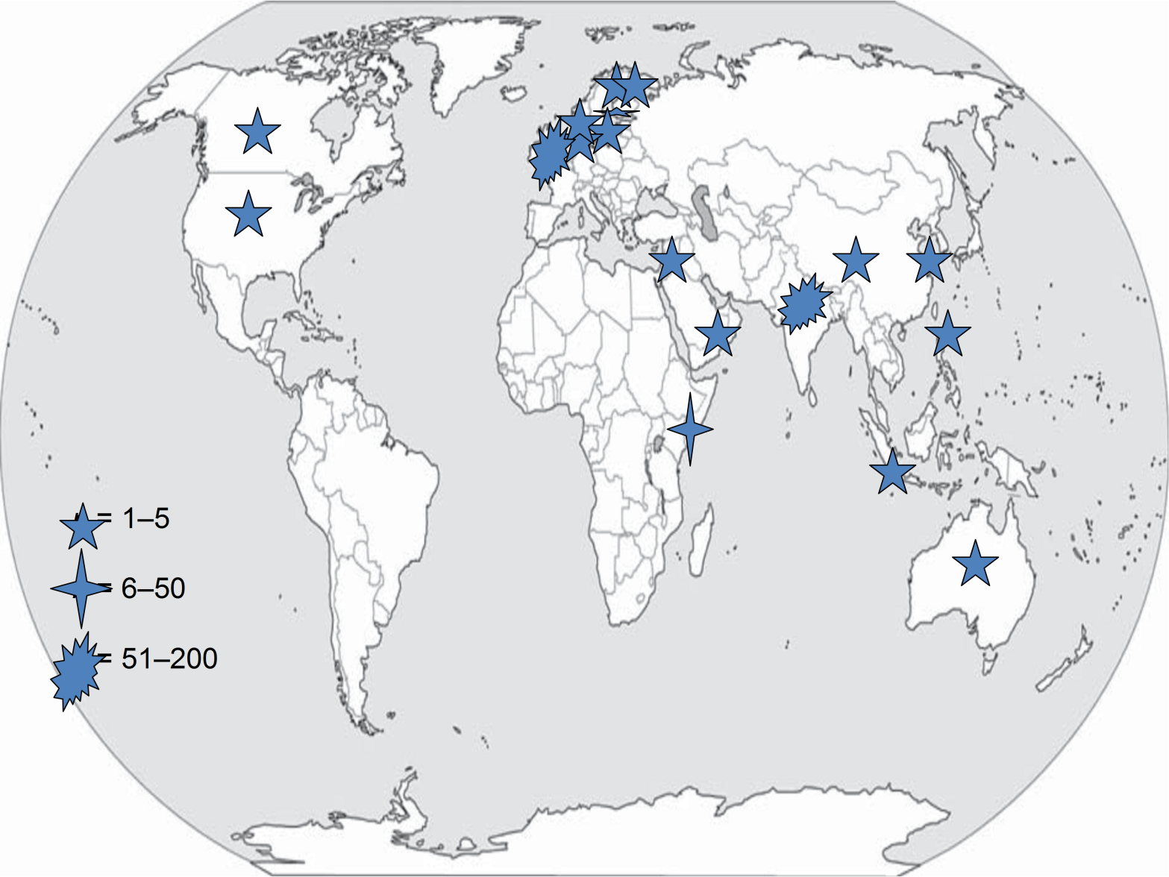
Worldwide Distribution of Cases of NDM-1* – Dec. 2010
(*New Delhi metallo-beta-lactamase 1 enzyme/ ‘superbug’)
Notes:
Important to note that in October of this year, the first case of NDM-producing Salmonella spp. likely acquired in India but detected in the U.S was reported. This is an example of how easily this enzyme is moving between species, and can be introduced into our foodborne pathogens (Salmonella).

Slide 3
The Epidemiology of Antimicrobial Resistance is Complex…
Fuel Ethanol
AQUACULTURE
Fuel Ethanol Producers
Sea / Lakes
Swimming
Drinking Water
Distillers Grain By-Products
Drinking water
Rivers and Streams
Industrial &
Household
Antibacterial
Chemicals
Land Fill
SOIL
Farm Effluents and Manure Spreading
Sewage
Dead stock
WILDLIFE
Rendering
Offal
Vegetation,
Seed Crops, Fruit
SWINE
HUMAN
SHEEP
CATTLE
HOSPITALIZED
COMMUNITY
- URBAN
-RURAL
Animal
Feeds
Re-mix
FOOD ANIMALS
Commercial
Abattoirs /
Processing
Plants
Handling
Preparation
Consumption
VEAL
CALVES
Meat
EXTENDED
CARE
FACILITIES
POULTRY
TRAVELLERS
OTHER
FARMED
LIVESTOCK
COMPANION
ANIMALS
Direct
Contact
IMPORTS
after Linton AH (1977), modified by Irwin RJ
Notes:
There are gaps in our surveillance and we are working to bridge these gaps. Regardless, there are good data coming our of the CIPARS program.
Focus on 5 main species – humans, chickens, pigs, cattle and turkey
Will quickly describe the main findings for each from the 2012 surveillance year.

Slide 4
Ceftiofur Resistance in Chicken E. coli and
Human and Chicken S. Heidelberg (Québec) – CIPARS
2003-2009, Rolling Average
High level of use
Zero use
Unknown use
preliminary
Canadian Integrated Program for Antimicrobial Resistance Surveillance , PHAC
3
Notes:
3
This is a good example of how CIPARS integrates information collected through their surveillance program. In 2003 and 2004 high levels of resistance to ceftiofur were observed in chicken E. coli and human and chicken Salmonella Heidelberg in Quebec. This information was shared with producers in this province which lead to a voluntary withdrawal of ceftiofur which was injected into eggs. The withdrawal of its use, as shown here for the years of 2005 and 2006, produced a reduction in resistance to ceftiofur in chicken E. coli and human and chicken S. Heidelberg. However, as of 2007, partial reinstitution of use has occurred, and has led to the increase of ressistance to ceftiofur in these bacteria.

